Slide 1

Final Project Presentation
Exploring Workplace Dynamics: A Visual Analysis of Stress, Work-Life Balance, and Mental Health Resources
By: Group No – 5
Shikha Chandel (801365577)
Satvik Nayak (801405756)
Shailesh Kumar (801433241)

Slide 2
Introduction
High stress, work-life imbalance, and limited mental health support
Negative impact on employee satisfaction, productivity, and organizational culture
Addressing mental health gaps in the workplace
Identifying areas for improvement in mental health accessibility
Providing actionable recommendations for enhancing workplace culture

Slide 3
Dataset Overview: OSMI Health (2017-2022)
Source: Open Sourcing Mental Illness (OSMI Health)
Timeframe: 2017-2022
Purpose: Sentiment analysis of employees' perspectives on mental health in the workplace.
Mental Health Benefits:
Does your employer provide mental health benefits as part of healthcare coverage?
Resources for Awareness:
Does your employer offer resources to learn more about mental health disorders and options for seeking help?
Comfort Level with Discussions:
Would you feel more comfortable talking to your coworkers about your physical health or your mental health?

Slide 4
Visualization Design
Radial Chart: Visualizes multivariate relationships to uncover trends and discrepancies in workplace dynamics.
Geo-Map: Maps regional disparities in treatment accessibility, emphasizing global patterns and gaps for targeted action.
Grouped Bar Chart: Clearly compares diverse response categories across workplace topics to highlight patterns and actionable insights.

Slide 5
Data Preprocessing Challenges & Solutions
Column Naming Standardization: Merged datasets had varying naming conventions. Standardized column names for clarity (e.g., "What is your age?" to "Age").
Sentiment Analysis Alignment: Combined similar values from repeated sentiment analysis questions to ensure dataset integrity.
Data Cleaning & Harmonization:
Standardized gender entries (e.g., "M", "Male" to "Male").
Reclassified ambiguous responses like "I don’t know" to "Maybe."

Slide 6
Geospatial & Data Structure Refinement
Geospatial Data Adjustments:
Harmonized country names for mapping (e.g., "United States of America" to "USA").
Integrated data seamlessly with geospatial tools using JSON files.
Versatile Dataset for Analysis:
Included demographic, workplace, and mental health-related variables.
Transformed into a structured resource for in-depth analysis and data-driven decision-making.

Slide 7
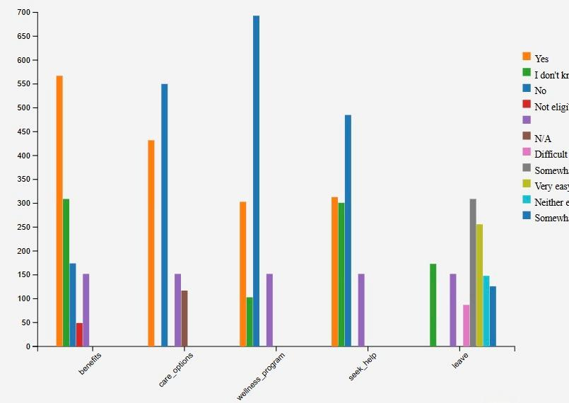
Male Employee Data - Challenges
Access to Resources
Lack of access to:
Mental health benefits.
Care options.
Wellness programs.
High "No" and "Not Eligible" responses.

Slide 8
Leave Policies
Mixed experiences with requesting leave:
Some find it easy.
Many report it as "Difficult".
Potentially influenced by workplace policies or cultural norms.

Slide 9
Hesitation to Seek Help
Evident reluctance to seek professional help.
Likely influenced by:
Societal stigma.
Workplace judgment.

Slide 10
Wellness Programs
High rejection or inaccessibility rates.
Misaligned with male employees' needs.

Slide 11
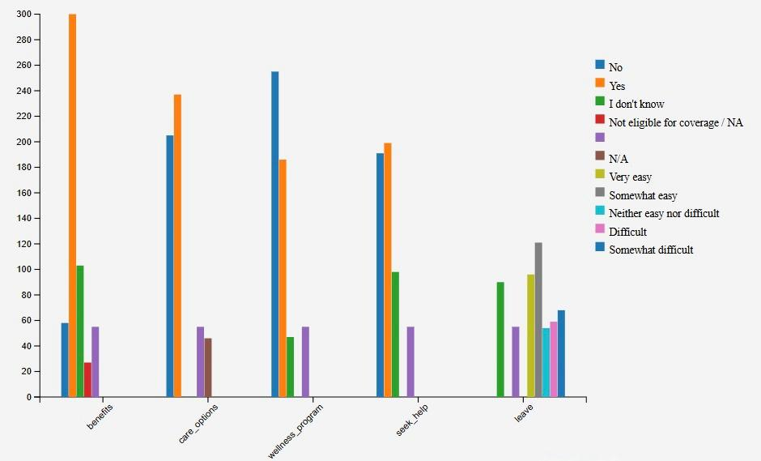
Female Employee Data - Challenges
Access to Resources
Limited access to:
Benefits.
Care options.
Wellness programs.
High "No" and "Not Eligible" responses.

Slide 12
Female Employee Data - Challenges
Leave Policies
Many report health-related leave as:
"Somewhat Difficult" or "Difficult."
Some find it "Somewhat Easy."
Barriers influenced by workplace policies or cultural norms.

Slide 13
Female Employee Data - Challenges
Seeking Help
Hesitation to utilize resources due to:
Societal stigma.
Workplace cultures discouraging mental health discussions.

Slide 14
Gender Comparison
Male vs. Female Challenges
Common Barriers:
Limited access to benefits and wellness programs.
Hesitation to seek professional help.
Differences:
Females face more difficulty in:
Taking leave for health reasons.
Males face more difficulty in:
Accessing and engaging with resources.

Slide 15

Recommendations
Enhance inclusivity and communication about resources.
1
Address gender-specific barriers in workplace policies.
2
Normalize mental health discussions to combat stigma.
3
Redesign wellness programs to meet employee needs effectively.
4

Slide 16
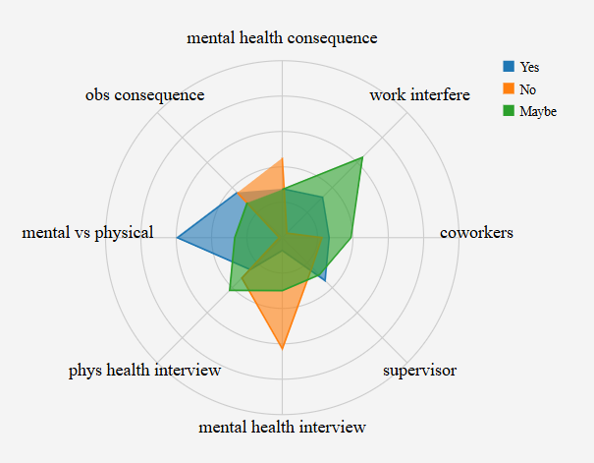
Male Participants - Key Insights
Mental vs. Physical Health
Male participants are more comfortable acknowledging physical health concerns than mental health.
Stronger "Yes" responses for physical health indicate:
Stigma around mental health persists.

Slide 17
Male Participants - Key Insights
Comfort with Discussing Health
Coworkers:
Higher proportion of "Maybe" and "Yes" responses.
Indicates relative comfort in discussing health matters.
Supervisors:
Larger share of "No" responses.
Workplace hierarchies may discourage openness.

Slide 18
Male Participants - Key Insights
Perceived Consequences
"No" Responses: Most do not anticipate direct negative outcomes.
"Maybe" Responses: Significant uncertainty remains due to:
Lack of clear workplace policies.
Limited communication about health disclosures.

Slide 19
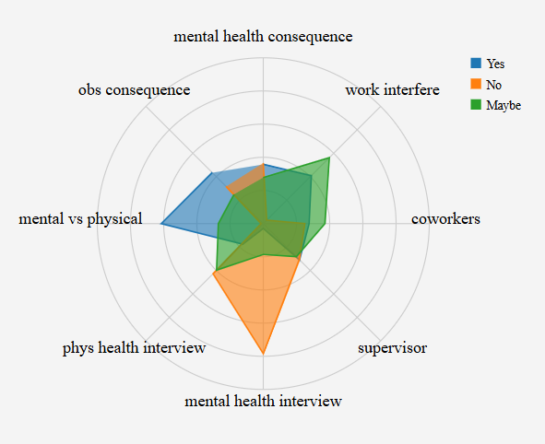
Female Participants - Key Insights
Mental vs. Physical Health
Female participants demonstrate balanced acknowledgment of both mental and physical health.
"Maybe" Responses highlight lingering hesitation and stigma around mental health.

Slide 20
Female Participants - Key Insights
Comfort with Discussing Health
Coworkers: Higher "Yes" and "Maybe" responses, indicating:
Greater comfort in peer discussions.
Supervisors: Lower comfort due to perceived authority barriers.

Slide 21
Female Participants - Key Insights
Perceived Consequences
Mixed responses across "Yes," "No," and "Maybe" in categories like:
Mental health consequence
Obs consequence
Uncertainty attributed to:
Unclear workplace policies.
Inconsistent support systems.

Slide 22
Gender Comparison - Insights & Trends
Similarities
Both genders acknowledge physical health more than mental health.
Comfort in discussing health is greater with coworkers than supervisors.
Differences
Females:
Show a more balanced acknowledgment of mental and physical health.
Slightly more openness toward health acknowledgment.
Males:
Exhibit higher "No" responses for comfort with supervisors.

Slide 23
Recommendation
Reduce Mental Health Stigma: Implement awareness campaigns to educate and normalize mental health discussions.
1
Foster Trust Between Employees and Supervisors: Build stronger relationships to create a supportive environment.
2
Clearly Communicate Policies on Health Disclosures: Ensure transparency about how health-related information is handled.
3
Encourage Open and Supportive Workplace Culture: Cultivate a space where employees feel comfortable discussing mental health without fear of judgment.
4
Enhance Workplace Trust: Strengthen the foundation of trust across all organizational levels.
5
Improve Communication on Health Disclosure Policies: Ensure employees understand their rights and available resources for health-related concerns.
6

Slide 24
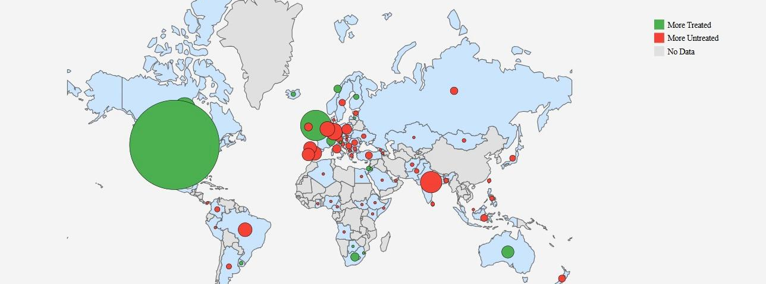
Key Features of the Geo Map
"More Treated" (Green): Regions where employees are undertaking mental health treatment.
"More Untreated" (Red): Regions where employees are not undertaking mental health treatment.
No Data (Gray): Regions lacking sufficient data.

Slide 25
Key Features of the Geo Map
Global Disparities in Mental Health Treatment
High variability in treatment access across regions.
Underserved Regions:
South America, Africa, and parts of Asia require urgent attention.

Slide 26
Recommendations
Increase Mental Health Resources and Treatment Accessibility in Underserved Regions: Expand the availability of care where it is needed most.
1
Promote Global Awareness of Mental Health Challenges: Create awareness initiatives to address mental health disparities worldwide.
2
Foster International Collaboration to Bridge Gaps in Mental Health Care: Collaborate globally to improve access to mental heal
3

Slide 27
Conclusion
Gender and Global Disparities: Significant gaps exist in mental health acknowledgment, treatment, and workplace support, with gender and regional differences in access and stigma.
Need for Inclusive Policies: Both workplace and global efforts are necessary to improve accessibility, reduce stigma, and foster open communication about mental health.
Call to Action: Prioritize mental health through education, awareness campaigns, and targeted interventions to create more supportive, inclusive, and equitable environments.

Slide 28

References
https://mhanational.org/sites/default/files/Mind%20the%20Workplace%20-%20MHA%20Workplace%20Health%20Survey%202021%202.12.21.pdf
https://osmi.typeform.com/report/Fja7Jb9K/t5F4sKEyeGhGgU7V
https://d3js.org/getting-started

Slide 29

THANK YOU

